Slide 1
Predicting Indian Restaurants close to hotels for best experience in New York City

Slide 2
Finding Restaurants closer to Hotels will give better experience for tourist who can enjoy the city as well as his/her favorite cuisine within walking distance.

Slide 3
Data Acquisition and cleaning
New York data set :
https://cocl.us/new_york_dataset
Indian Restaurants and Hotels from Foursquare API
By using this API we will get all the venues in each neighbourhood. We can filter these venues to get only Indian restaurants.
Use geopy library to get the latitude and longitude of New York city.

Slide 4
Data Acquisition and cleaning
New York data set :
https://cocl.us/new_york_dataset
Indian Restaurants and Hotels from Foursquare API
By using this API we will get all the venues in each neighbourhood. We can filter these venues to get only Indian restaurants.
Use geopy library to get the latitude and longitude of New York city.
Data set has 5 Boroughs and 306 neighborhoods
Data wrangling is done to filter out all the columns not needed while finding hotels through Foursquare.

Slide 5
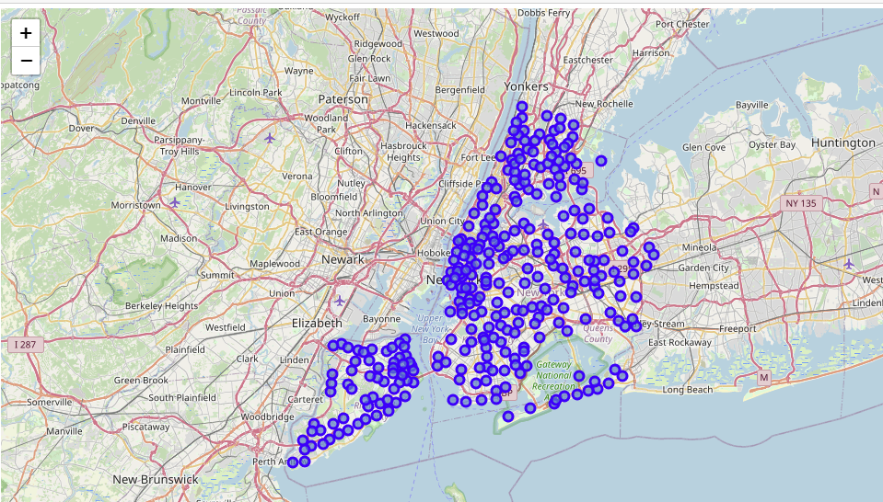
NewYork City’s Longitude and Latitude

Slide 6
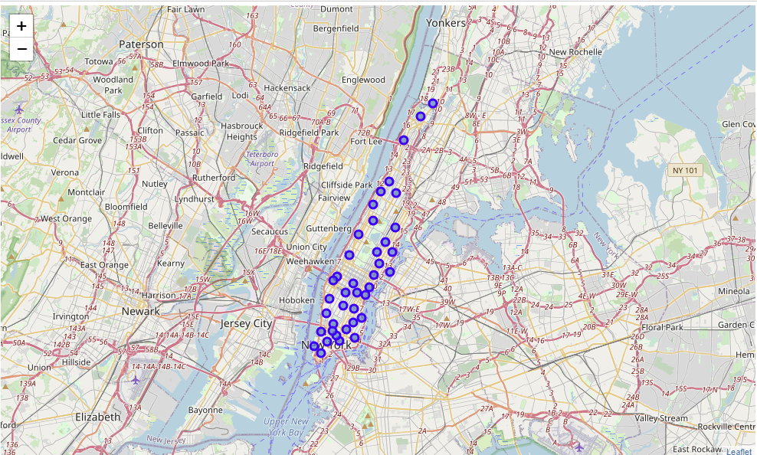
Focusing on Manhattan as it has maximum number of Indian Restaurants

Slide 7
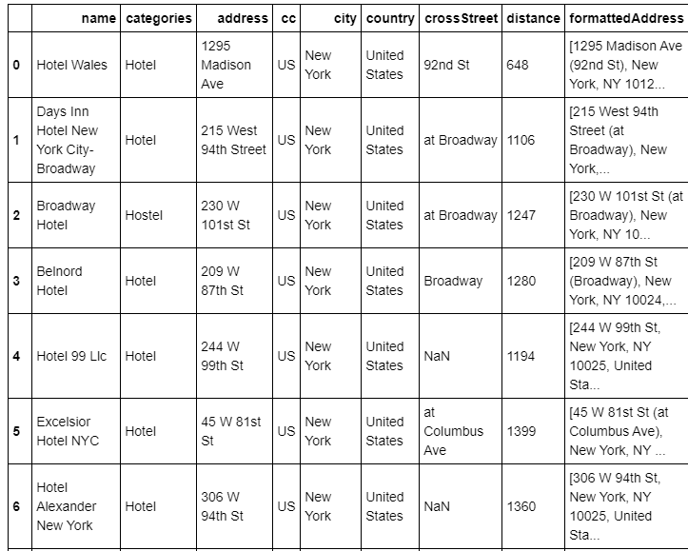
Foursquare API for finding hotels in Manhattan

Slide 8
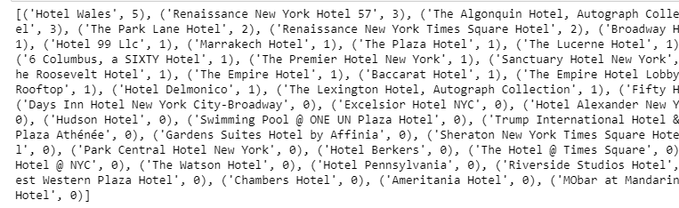
Foursquare API for finding IndianRestaurants within 10 mile radius of hotel

Slide 9
Conclusion and Result: We found out the maximum number of Indian Restaurants are closer to Hotel Wales in Manhattan. There is always different ways to find out the solution to problem. I have found a small glimpse of how real life problems could be solved through Data Science. Finally you have any friend visiting New York, they can use this to find out which hotels would fit best to their dietary need. I have given an example of Indian Restaurant but this can be used to find out any cuisine which a tourist is interested in.

